Slide 1

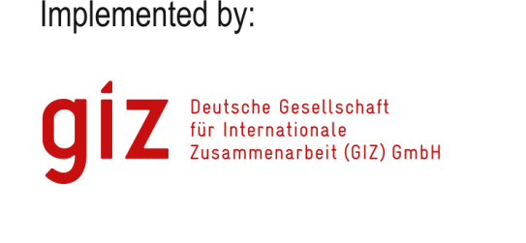

K-LINK A narrative (maybe a bit conceptual) introduction

Slide 2
KLINK – the rationale in few words
Knowledge Management

Slide 3
KLINK – the rationale in few words
Knowledge Management
Reliable Resources detection in the field of Natural Resource Management and climate resilience

Slide 4
KLINK – the rationale in few words
Knowledge Management
Reliable Resources detection in the field of Natural Resource Management and climate resilience
What are reliable resources about? Statistics, Best Practices, valuable past experiences (both positive and negative), scientific and project reports, deliverables, etc.

Slide 5
KLINK – the rationale in few words
Knowledge Management
Reliable Resources detection in the field of Natural Resource Management and climate resilience
What are reliable resources about? Statistics, Best Practices, valuable past experiences (both positive and negative), scientific and project reports, deliverables, etc.
What these reliable resources are for? Projects proposal and monitoring in Natural Resource Management (NRM) and Climate Resilience (CR)

Slide 6
KLINK – the rationale in few words
Knowledge Management
Reliable Resources detection in the field of Natural Resource Management and climate resilience
What are reliable resources about? Statistics, Best Practices, valuable past experiences (both positive and negative), scientific and project reports, deliverables, etc.
What these reliable resources are for? Projects proposal building and projects monitoring in Natural Resource Management (NRM) and Climate Resilience (CR)
KLINK main issue: Where to find and how to improve their search?

Slide 7
KLINK – the rationale in few words
Knowledge Management
Reliable Resources detection in the field of Natural Resource Management and climate resilience
What are reliable resources about? Statistics, Best Practices, valuable past experiences (both positive and negative), scientific and project reports, deliverables, etc.
What these reliable resources are for? Projects proposal building and projects monitoring in Natural Resource Management (NRM) and Climate Resilience (CR)
KLINK main issue: Where to find and how to improve their search?
In documents and data repositories

Slide 8
KLINK – the rationale in few words
Knowledge Management
Reliable Resources detection in the field of Natural Resource Management and climate resilience
What are reliable resources about? Statistics, Best Practices, valuable past experiences (both positive and negative), scientific and project reports, deliverables, etc.
What these reliable resources are for? Projects proposal building and projects monitoring in Natural Resource Management (NRM) and Climate Resilience (CR)
KLINK main issue: Where to find and how to improve their search?
In documents and data repositories
Through KLINK

Slide 9
K-LINK Linking sharing and managing knowledge on climate change in Central Asia
SIRIS

Slide 10



Why KHUB 2.0?
The main idea of KHUB 2.0 is to facilitate the sharing of resources among stakeholders working in the field of climate resilience

Slide 11
Some assumptions
A Knowledge Management initiative for cooperation in Central Asia
Will be successful on the condition that
it enables sharing
whilst respecting ownership
without imposing a single model

Slide 12
HOW TO DESIGN THE SYSTEM?

Slide 13
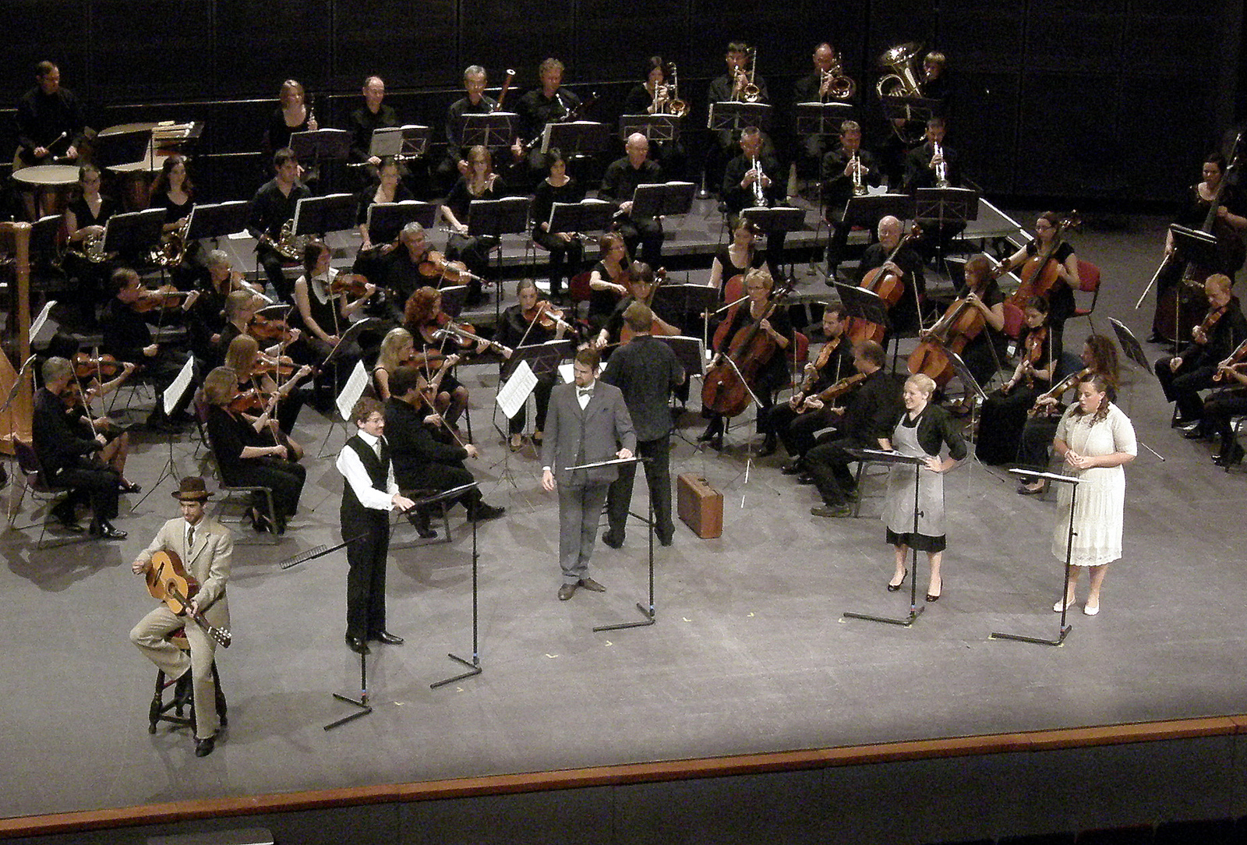
By building up an ORCHESTRATOR of pre-existing platforms containing information and core documents about Natural Resource Management (NRM) in Central Asia

Slide 14
KHUB 2.0 Proposal
All in all the KHUB 2.0 proposal presents a possible technical solution to this problem, based on
the use of a distributed network;
in which all data and information remains stored on each institution’s server and can be accessed from each institution’s website;
without the need to create a central hub.

Slide 15
KHUB 2.0 Proposal → KLINK
All in all the KHUB 2.0 proposal presents a possible technical solution to this problem, based on
the use of a distributed network;
in which all data and information remains stored on each institution’s server and can be accessed from each institution’s website;
without the need to create a central hub.

Slide 16



Global/Local Search
LOCAL INSTITUTION
Distributed
(Global)
Search
LOCAL INSTITUTION
Main Requirement:
Local search over local repositories of Documents
Main Service:
Local search results
Main Processing:
Automatic Analysis of document content
LOCAL INSTITUTION

Slide 17
Benefits - Local Level
LOCAL INSTITUTION
KLINK
If no pre-existing Document Management system or web sites available, to provide institutions with a easy to use tool for managing and retrieving documents
If Document Management services pre-exists, to enhance them with:
Automatic document organization
Advanced search features
Storage and back-up services
LOCAL INSTITUTION
KLINK

Slide 18
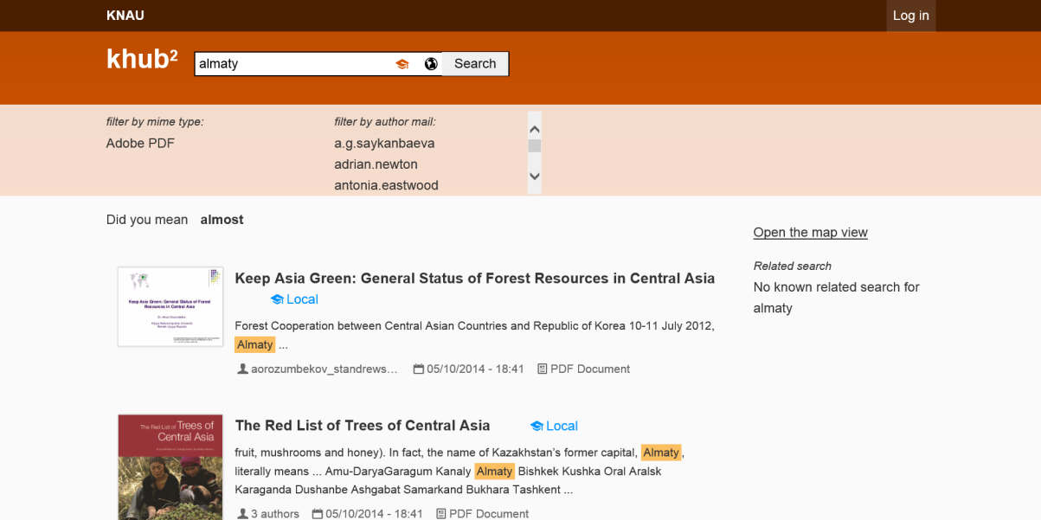
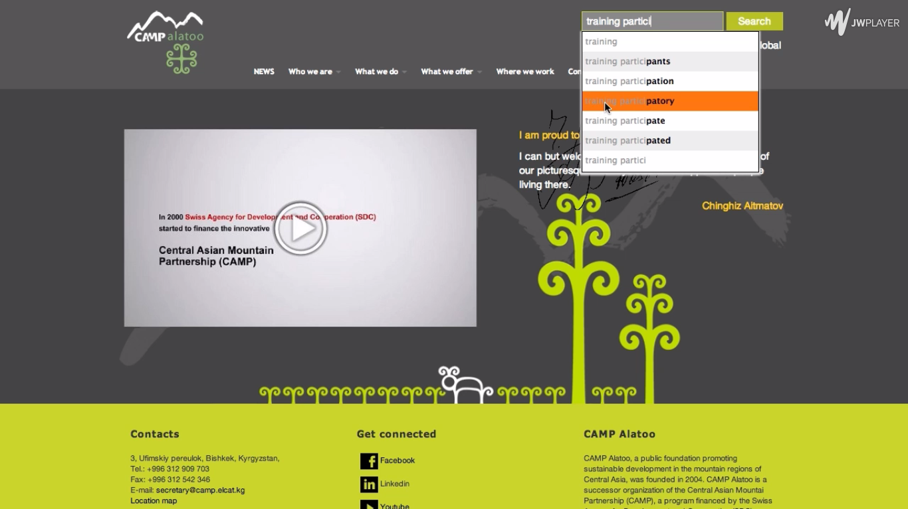
Benefits - Local Level
If no pre-existing Document Management system or web sites available, to provide institutions with a easy to use tool for managing, storaging and retrieving documents
If Document Management services pre-exists, to enhance them with:
Automatic document organization
Advanced search features
Storage and back-up services

Slide 19

Benefits - Local Level Search and preview documents in the browser

Slide 20
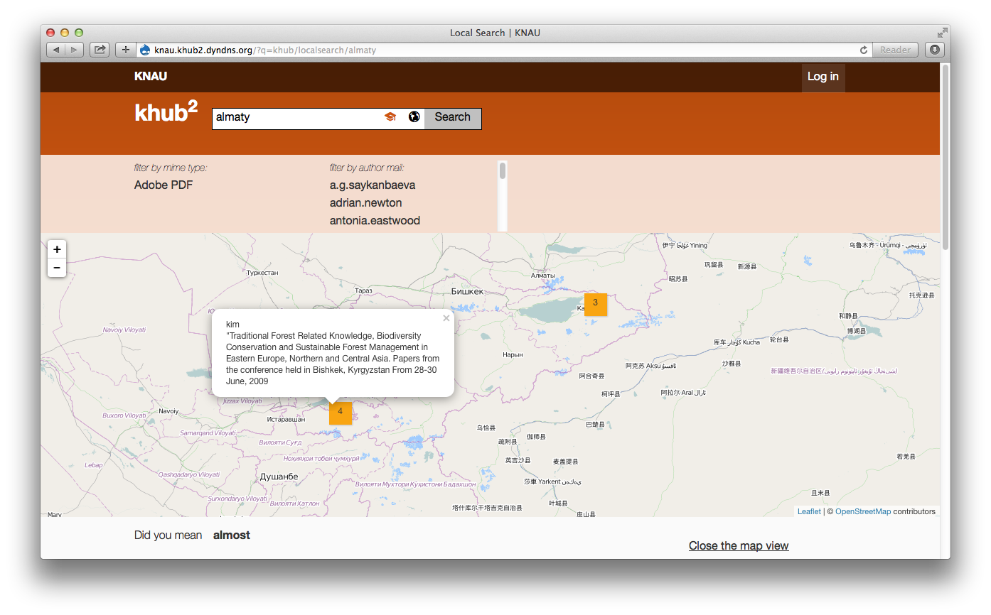
Benefits - Local Level Geo-position documents

Slide 21
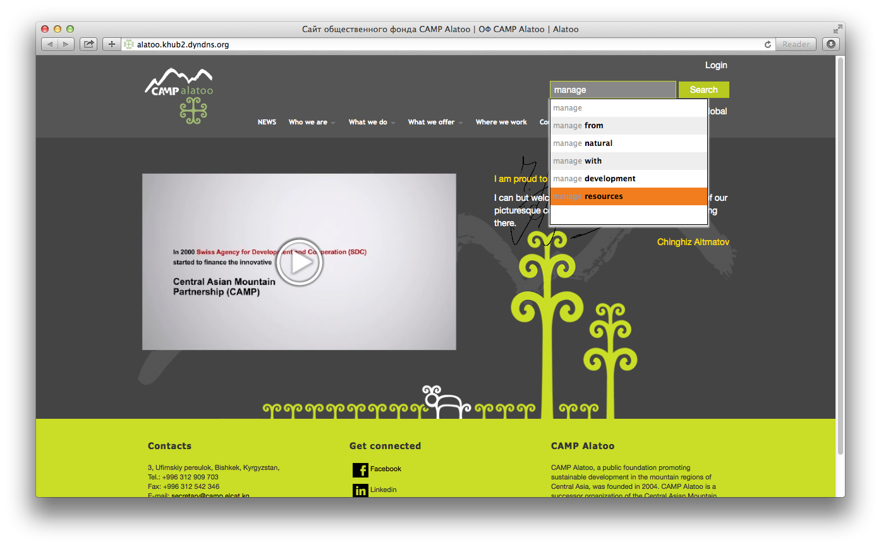
Benefits - Local Level Enhance search on existing systems

Slide 22
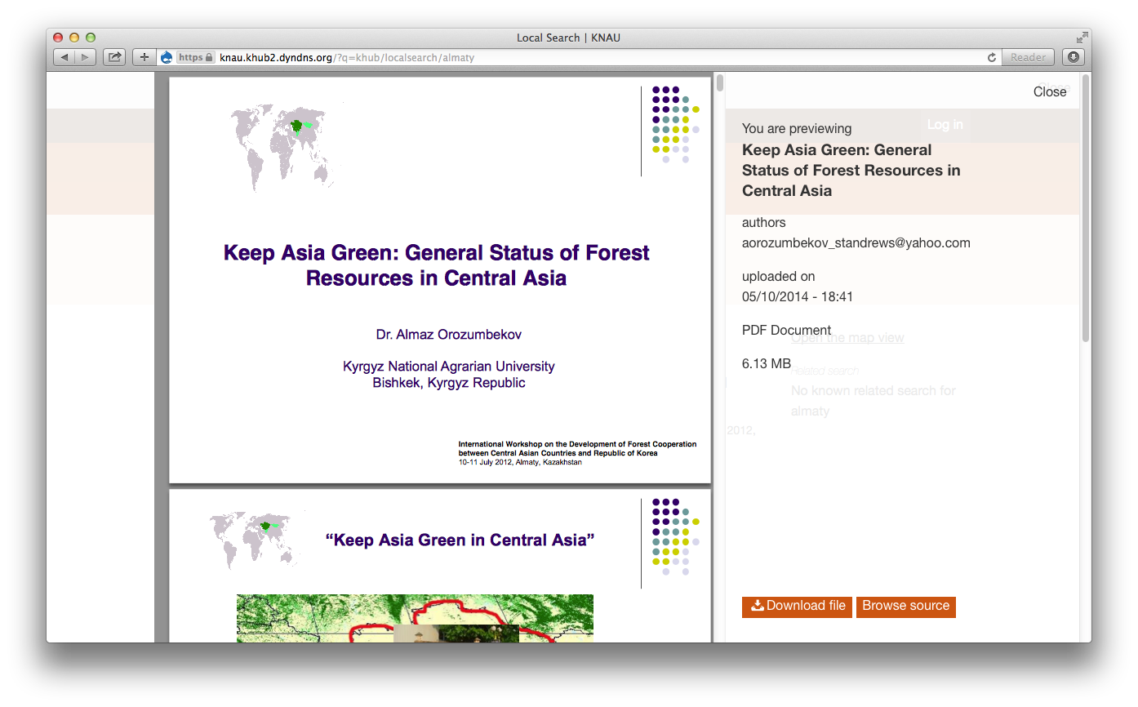
Benefits - Local Level Search and preview documents in the browser

Slide 23



KLINK / Storage services
File upload on your own server
Relaxing the need to organize documents in folders
Full document search
GIS integration
File upload on external server
Folder organization
Simple search based on document name
No GIS integration

Slide 24
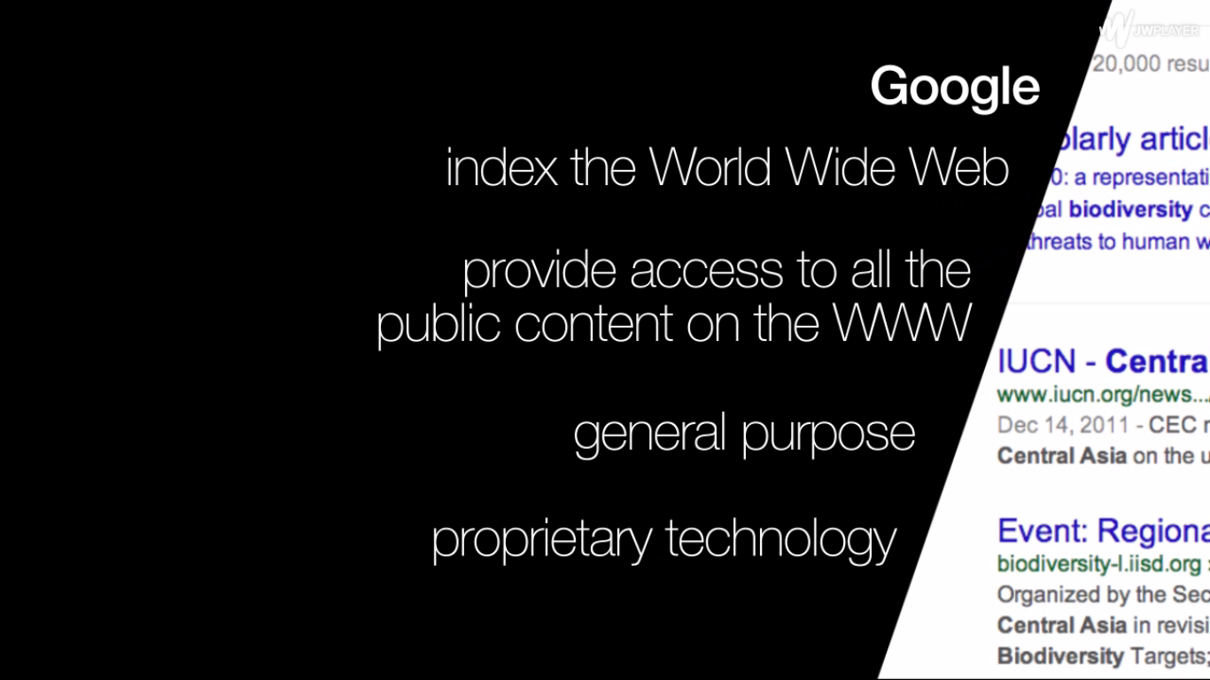
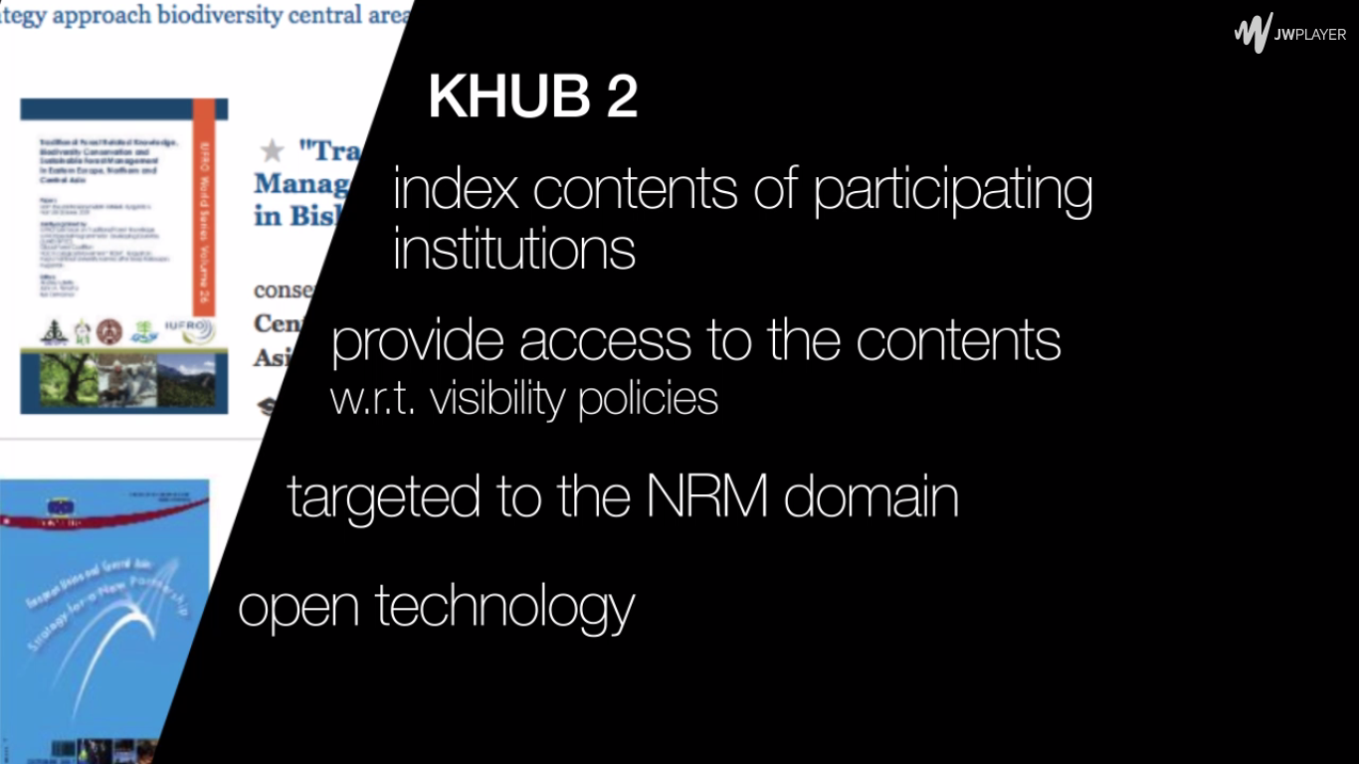
Google / KLINK
Google deals with any documents put on the web by heterogeneous users and for multiple and different reasons
KLINK deals with only documents intentionally uploaded by the stakeholders

Slide 25
Benefits – Global Level
Privacy
Documents sharing among institutions
by preserving ownership
by preserving internal local policies
without forcing anybody to share
Detecting reliable information sources
Promoting resources and contributions and access to information
Sharing
Ownership
Distribution

Slide 26
Benefits of KLINK as a whole
Resilience: If one of the local platform “goes down” it will still be possible to perform both global and local search
Risk assessment: Even if users do not share documents, the KLINK still make sense at the local level
Step by step strategy
Starting with few institutions
Monitoring the KLINK use over time
Monitoring the networks growing over time
Take decision on future steps
Sustainability & Capacity building: CA software companies involved

Slide 27
Efforts from end users
How may an organization to take part into the KHUB2
3 days for analyzing pre-existing systems with end users
KHUB2 will be run like any app of any browser
What is needed
It’s easy, no technical competence are required
It’s simple, no taxonomies development or data base definition are required
Maintenance:
normal maintenance required by any server machine
updating of the software components in charge to the KHUB2 server machines providers (universities and local software houses)

Slide 28
Roadmap
Output 1: K-LINK pilot
at local level from scratch (with 2 institutions)
integration with pre-existing platforms running at local level (with 1 institutions)
Output2: Steering Committee arranged
Output3: Continuing capacity development
Output4: Results dissemination to collect stakeholders, funds and extending the users network within and beyond Central Asia

Slide 29
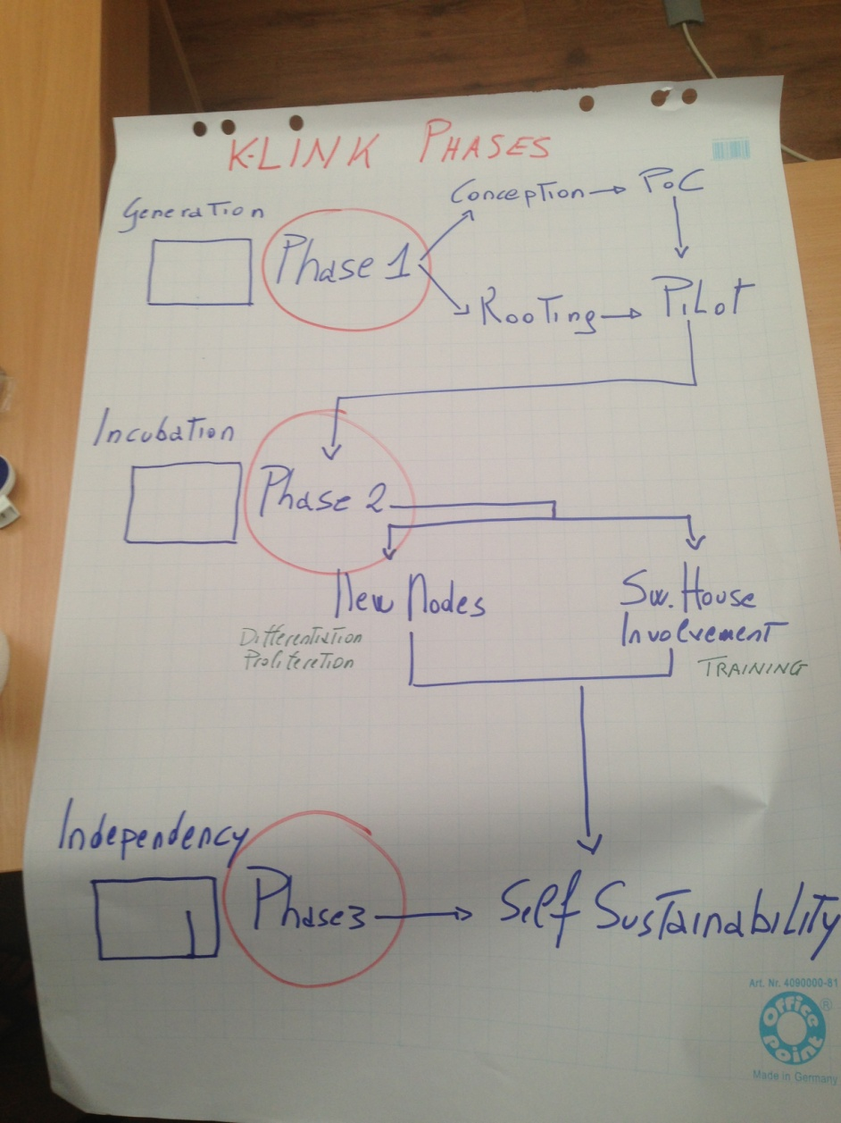
Roadmap
PHASE 1
Generation
Conception
PoC
Rooting
Pilot
differentiation/
proliferation
New Nodes
PHASE 2
Incubation
Sw Houses/
Universities
training
PHASE 3
Independency
Self
Sustainability

Slide 30
Phase – 2 Capacity Development
The main idea discussed with stakeholders, is to look at KLINK as a Trojan horse for triggering knowledge transfer processes.
During the knowledge acquisition campaign many meetings have been done with local software houses in order to involve them in the KLINK development activities and to provide them with skills and competences in:
distributed systems design, development and maintenance
search engines and information retrieval systems
semantic web and knowledge engineering

Slide 31
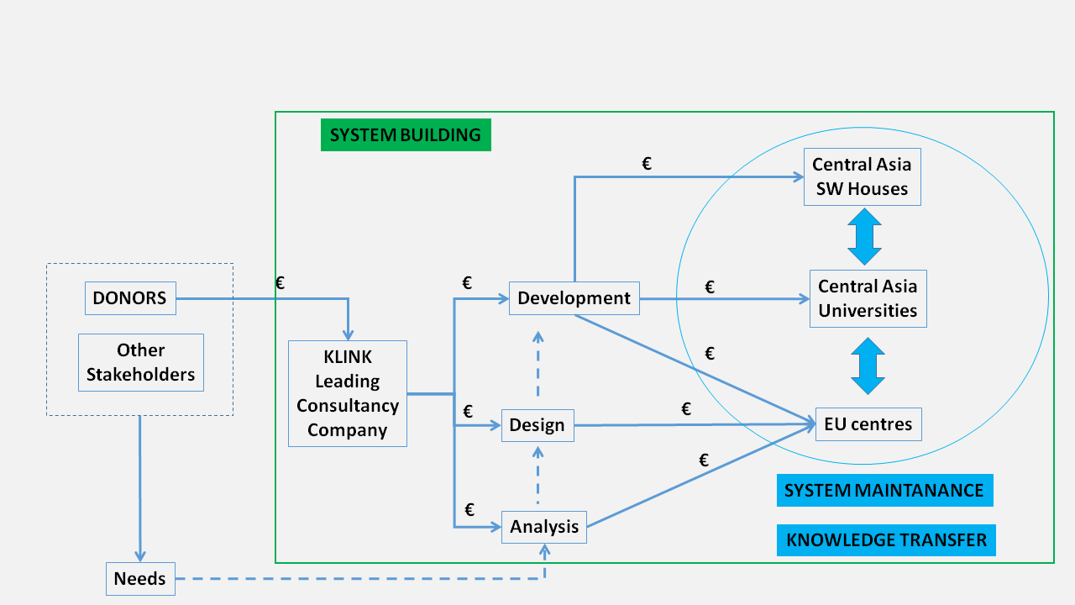
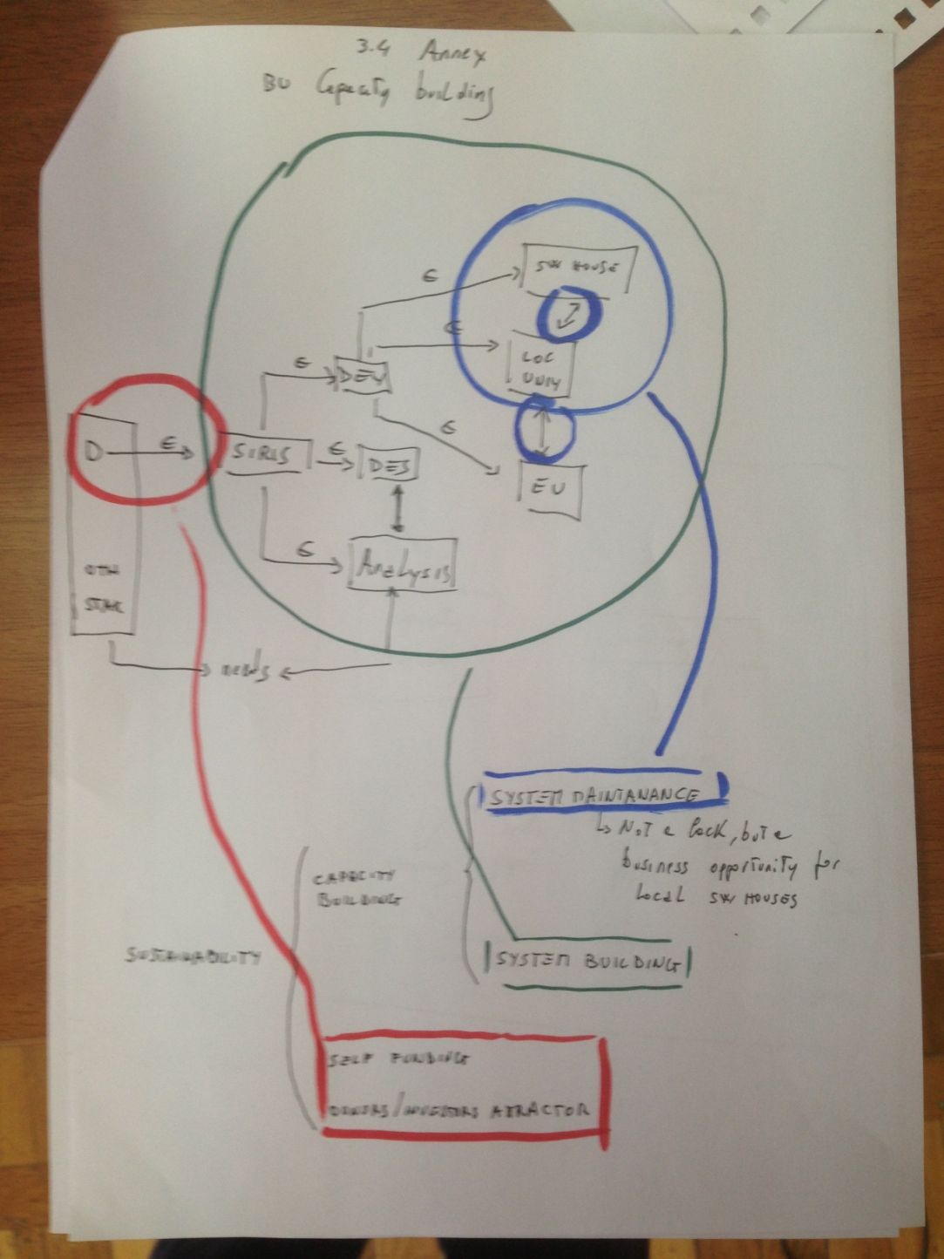
Phase – 2 Capacity Development

Slide 32
Phase – 2 Capacity Development
The basic idea for sustaining at long run KLINK is in few words the following:
Local software houses are selling space memories and associated services to other private companies
By working on the KLINK development local software houses may enrich their competencies in cloud computing and remote document management services
In this way they can enhance and extend their cloud services offer and at the same time to work as KLINK providers
They may use the KLINK as a way for extending their business beyond Central Asia, in the direction of Europe where skills in document management, social computing and semantic analysis are even more required. In this sense KLINK may also work as offer and demand attractor both in Central Asia and on the Central Asia/Europe axis

Slide 33
Phase – 2 Capacity Development
The sustainability model will be thus rooted into the core business of local software houses. In order to trigger this process, some actions are planned:
To involve local software houses in the development of the KLINK pilot
KLINK deployment
KLINK development
Internships and fellowships financed by the KLINK initiative in order to promote the active involvement of Technological Universities of Central Asia and European Universities in the settlement of continuous training courses on distribute systems design, information retrieval, text mining and knowledge management (internships and fellowships).
During the last month the interests of Universities at Bishkek in this direction have been investigated. The reaction was more than positive: especially the TAIC (Training and Innovation Center) declared a strong interest in participating (TAIC activated many spin off with private software houses)
To involve also for the prototype the participation of at least one private companies with interests in natural resource management

Slide 34
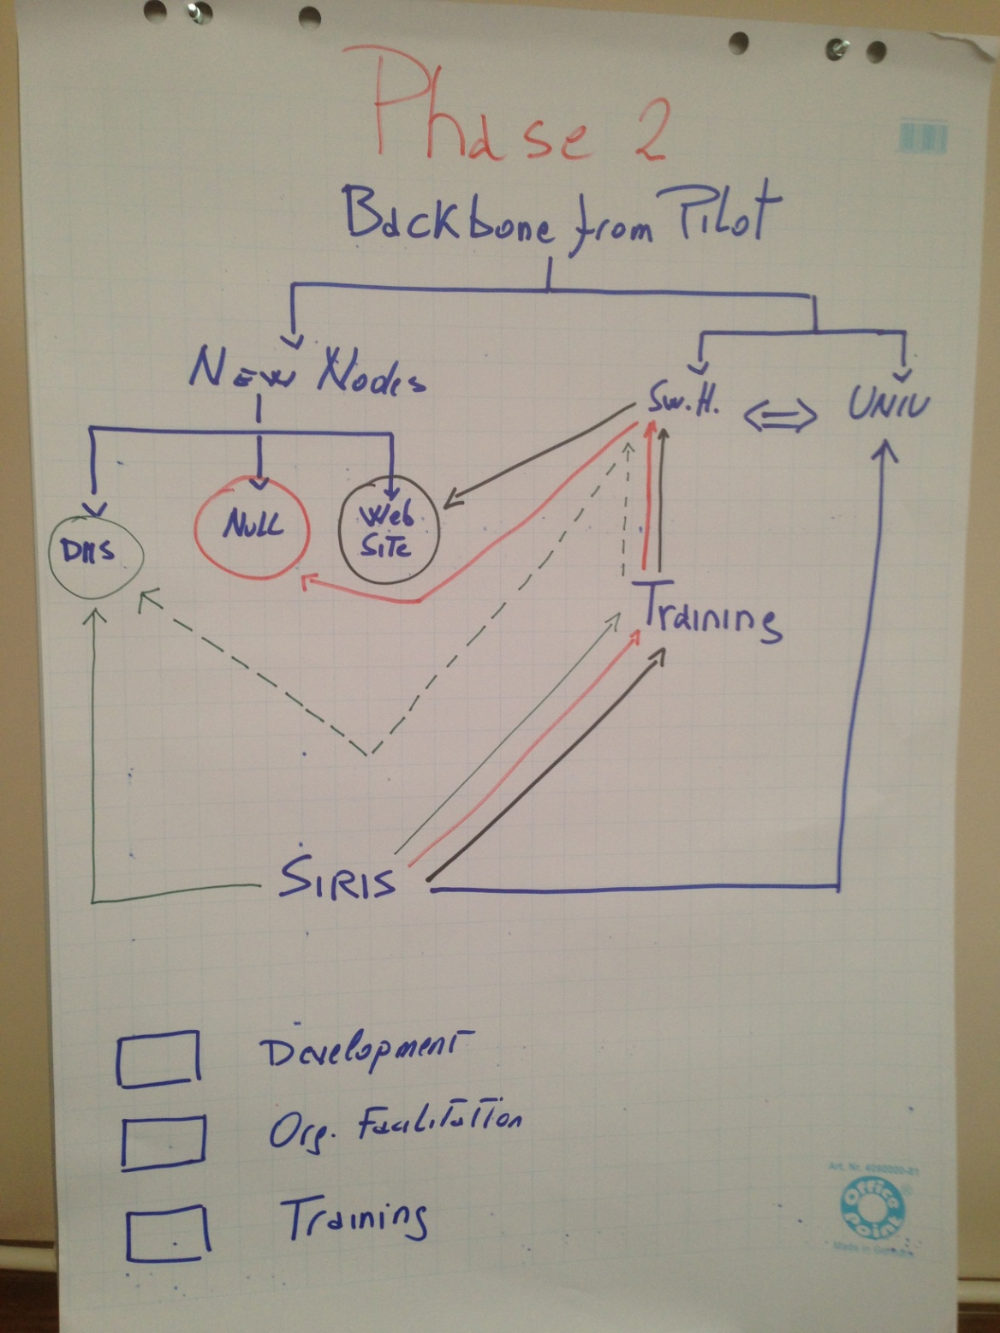
Phase – 2 Capacity Development
The main idea discussed with stakeholders, is to look at KLINK as a Trojan horse for triggering knowledge transfer processes.
Training local Sw Houses on
KLINK deployment
KLINK development
Recruiting local sw experts for promoting and didsseminating KLINK to stakeholders
Starting to discuss with universities (both CA and EU ) of courses, lessons, masters, internship etc.

Slide 35
http://www.khub2.net/
THANKS

